Slide 1
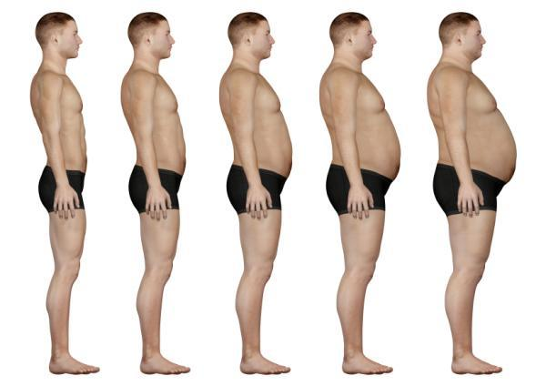
Metabolic Diseases
Lesson 3.1
What is obesity and how does BMI relate?

Slide 2
Do Now
What IS obesity?
  Body fat greater than 25% for men and 32% for women.
  Body mass index (BMI) over 30

Slide 3
Do Now
Why is obesity a health concern?
What chronic problems might it lead to?

Slide 4
Obesity affects every organ system
System | Examples of comorbidity
Cardiovascular | Atherosclerosis; Coronary heart disease; Hypertension; Congestive heart failure; Peripheral artery disease
Pulmonary | Sleep apnea; Asthma; Pulmonary embolus
Immune | Reduced immune response
Endocrine | Type 2 diabetes; Dyslipidemia
Gastrointestinal | Gastroesophageal reflux; Fatty liver disease
Musculoskeletal | Osteoarthritis; Back pain; Gout
Cancer | Breast; Prostate; Colon
Neurological | Macular degeneration; Depression
Psychosocial | Discrimination; Quality of life; Absenteeism

Slide 5
The percent of people that are overweight in the US is changing
Overweight: BMI ≥ 25 < 30
Obese: BMI >30

Slide 6
The percent of people that are obese in the US is increasing
Overweight: BMI ≥ 25 < 30
Obese: BMI >30

Slide 7
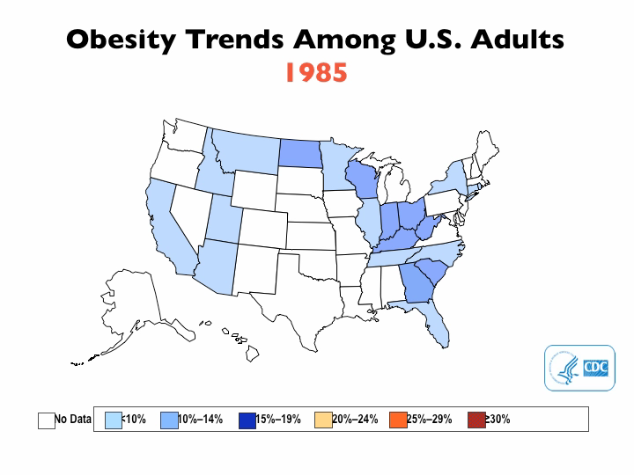

Slide 8
Obesity
  Body fat greater than 25 % for men and 32 % for women.
  Body mass index (BMI) over 30
What is body composition?

Slide 9
Two general ways to measure body composition
  Directly measure body fat
  Indirectly measure height and weight and relate it to body fat

Slide 10
Measure height and weight and relate it to body fat
Body Mass Index (BMI)
    A ratio that assumes a direct relationship between height and weight.

Slide 11
Activity:
Calculate Bill’s and Bob’s Body Mass Index (BMI)
BILL |  | BOB
6’1’’ | Height | 5’8’’
260 lbs | Weight | 210 lbs

Slide 12
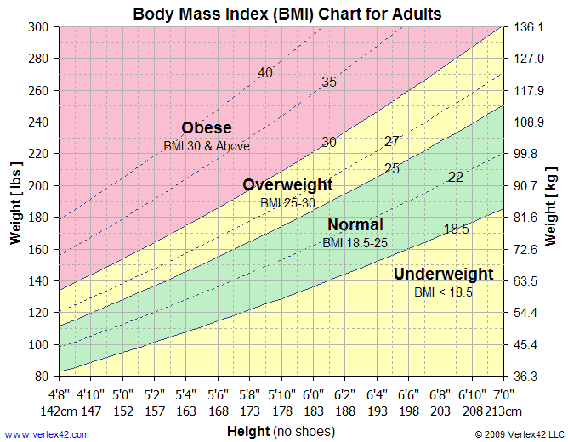
Calculate Bill’s & Bob’s BMI
BMI = weight (kg) height (m)²

Slide 13
Activity:
Calculate Bill’s and Bob’s Body Mass Index (BMI)
BILL |  | BOB
6’1’’ | Height | 5’8’’
260 lbs | Weight | lbs
34.67 | BMI | 31.88
OBESE |  | OBESE

Slide 14
Bill’s & Bob’s BMI

Slide 15
Activity:
Calculating and critiquing Body Mass Index (BMI)
  Most of the data we see for national trends of obesity are based on BMI. Do you think this is a problem? Why or why not?
  Share your thoughts with the class

Slide 16
We can directly measure body fat by:
What’s a better way to measure if an individual is a healthy weight?
    Body density in water
    Thickness of subcutaneous fat just under the skin
    DEXA Scan
    Bioelectrical impedance

Slide 17
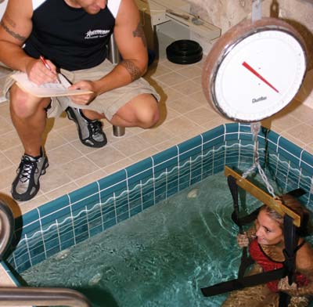
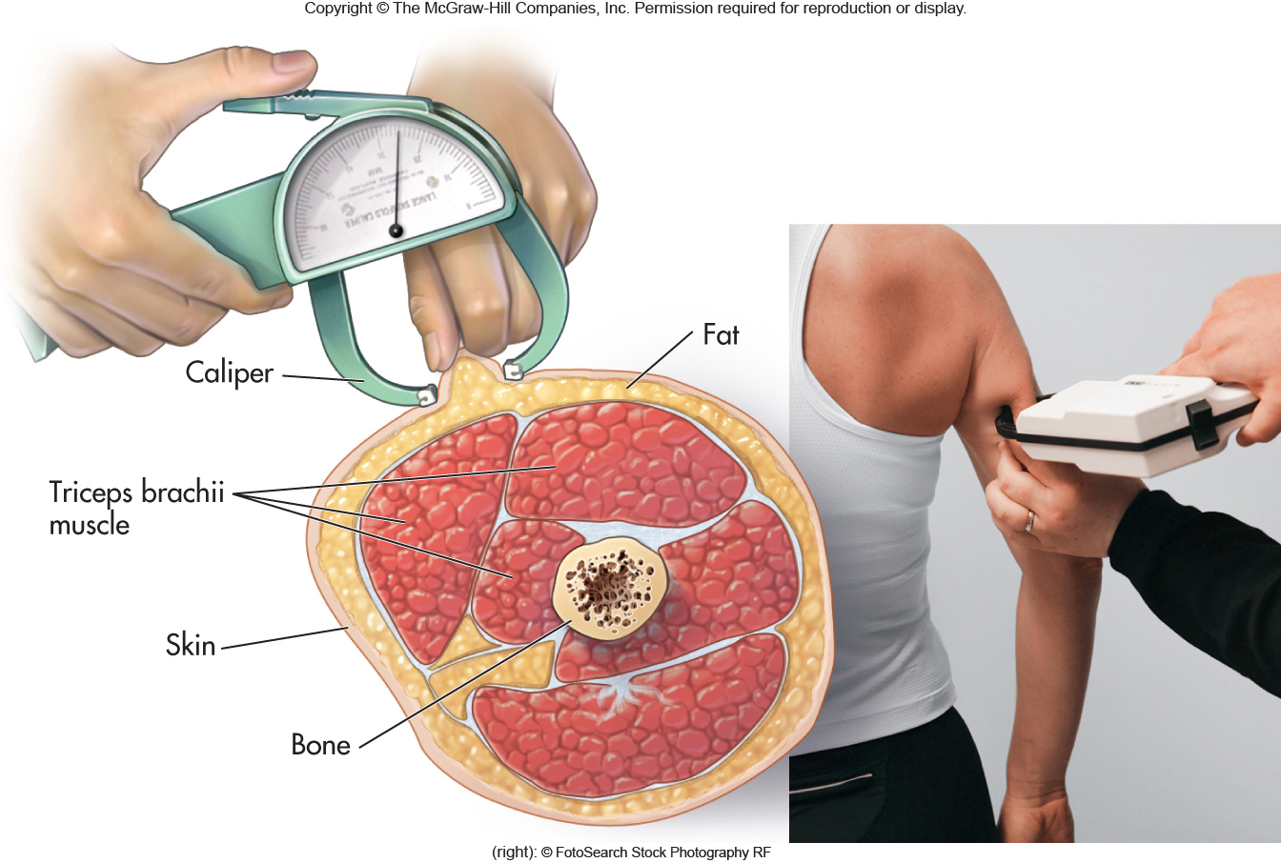
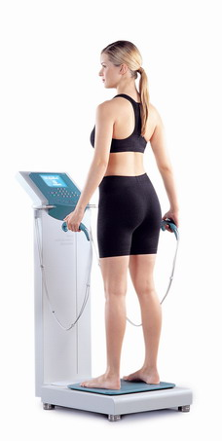
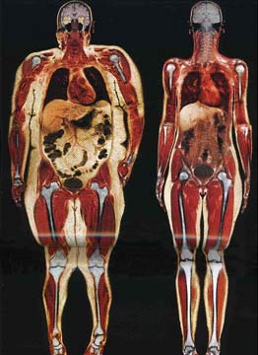
We can directly measure body fat by:
    Body density in water
    Thickness of subcutaneous fat just under the skin
    DEXA Scan
    Bioelectrical impedance

Slide 18
Women and Men need different amounts of body fat to be healthy
How much fat: | Women | Men
Too much? | >32% | >25%
Average? | 25-32% | 18-24%
Essential? | 8-12% | 3-5%
If you are fit? | 21-24% | 14-17%
If you are an athlete? | 14-20% | 6-13%

Slide 19
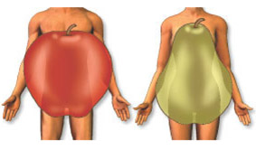
Where’s the fat? It matters!
Notes:
Relationship between heart disease and body shape, the reason being visceral fat vs subcutaneous fat

Slide 20
Where’s the fat? It matters!
Visceral fat
Subcutaneous fat
Subcutaneous fat
Not all body fat is created equal!
Notes:
Purpose of both types of fat

Slide 21
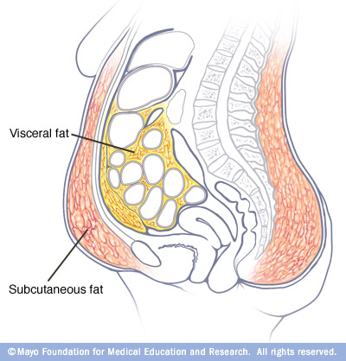
We have fat for a reason!
What is the purpose of visceral fat?
What is the purpose of subcutaneous fat?
Visceral Fat
Subcutaneous Fat

Slide 22
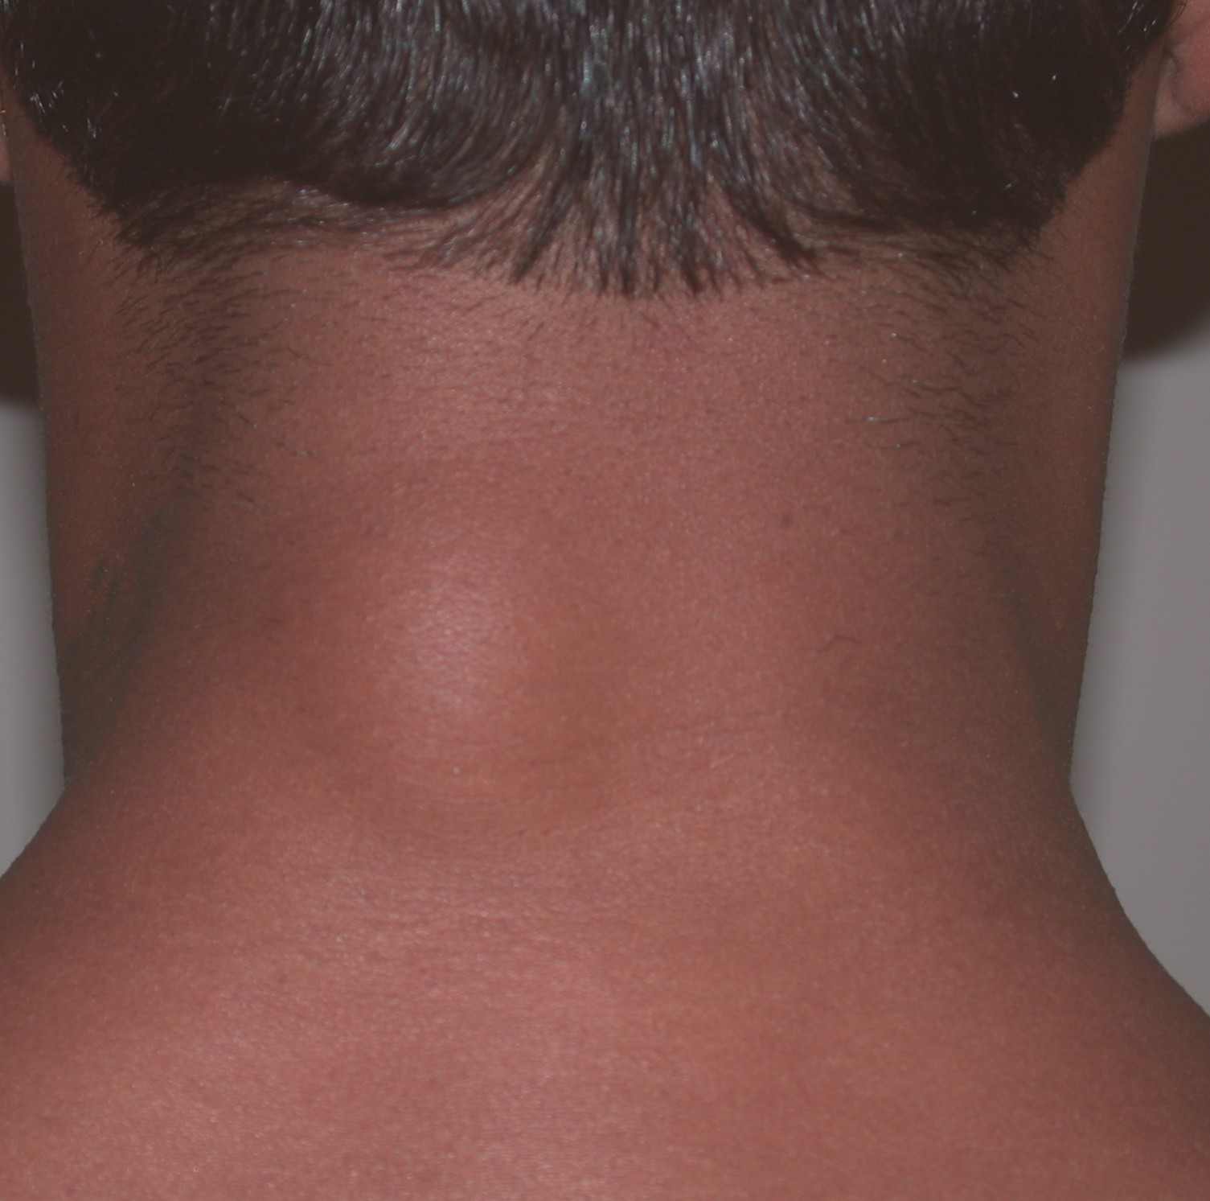
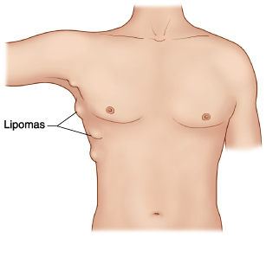
Disorders of adipose: Lipoma
What happens when fat is stored in “unusual” places?
Notes:
Benign tumor made of fat. May be heritable. Most common in adults 40-60 years old.

Slide 23
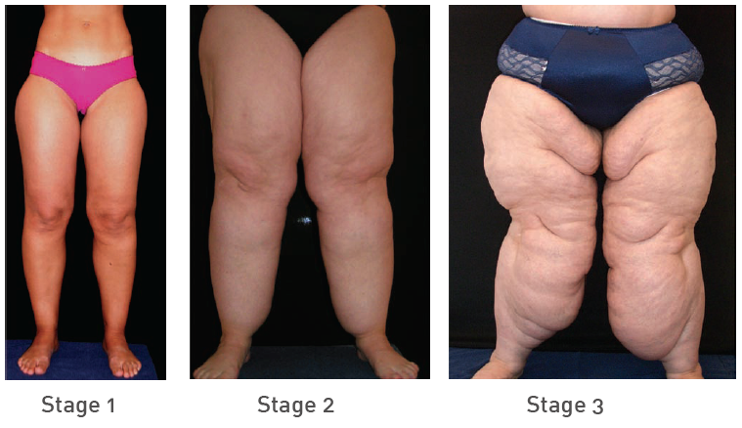
Disorders of adipose: Lipidema
What happens when fat is stored in “unusual” places?
Notes:
Mostly occurs in women
May be genetic (heritable)
Abnormal build up of adipose in the legs, even if weight is lost above the waist
Legs are tender and bruise easily
The extra fat can block lymph from traveling out of the legs, causing the lymph to gather in the legs and cause extra swelling.

Slide 24
Wrap Up
What factors contribute to obesity?
  Weight gain is caused by positive energy balance
  (Positive energy balance is when there is more energy coming into the body than what is being used)

Slide 25
Wrap Up
What factors impact your calorie allowance?
  Gender
  Age
  Activity
  Resting metabolism
  Height
  Lean muscle mass (the amount of muscle you have)

Slide 26
Homework
Begin to explain resting metabolic rate using the Lesson 3.1 Homework worksheet

